Slide 1
Investigating the English Premier League
Omar Moustafa (900222400)
Nour Kahky (900221042)
DSCI 3415 Project
May 22, 2025

Slide 2
Table of Contents
01
04
The Dataset Overview
The Per-Team Accuracy Plot
02
05
The Research Question
The Sample Predictions
03
06
The Models
Conclusion

Slide 3
Dataset Overview
The Objective
Use Case
This project explores how in-game events can be used to predict the final outcome of football matches.
The goal is to analyze and extract meaningful features from real-time match data to predict whether a team will win, lose, or draw while the game is still in progress.
By accurately predicting outcomes, coaches can receive real-time tactical insights and adjust their strategies to enhance performance during the match.

Slide 4

The Research Question
Can we predict the match winner based on
first-half events?

Slide 5
Modeling Approach and Evaluation Strategy
Implemented Classification Models:
Logistic Regression
Random Forest
K-Nearest Neighbors (KNN)
Evaluation Methodology:
Data was split into 80% training and 20% testing (80/20)
Each model was run 10 times using repeated splits to ensure reliable performance estimates
Outputs Collected for Each Model:
Average Accuracy of all runs
Top Predictive Features
Confusion Matrix summarizing classification performance

Slide 6
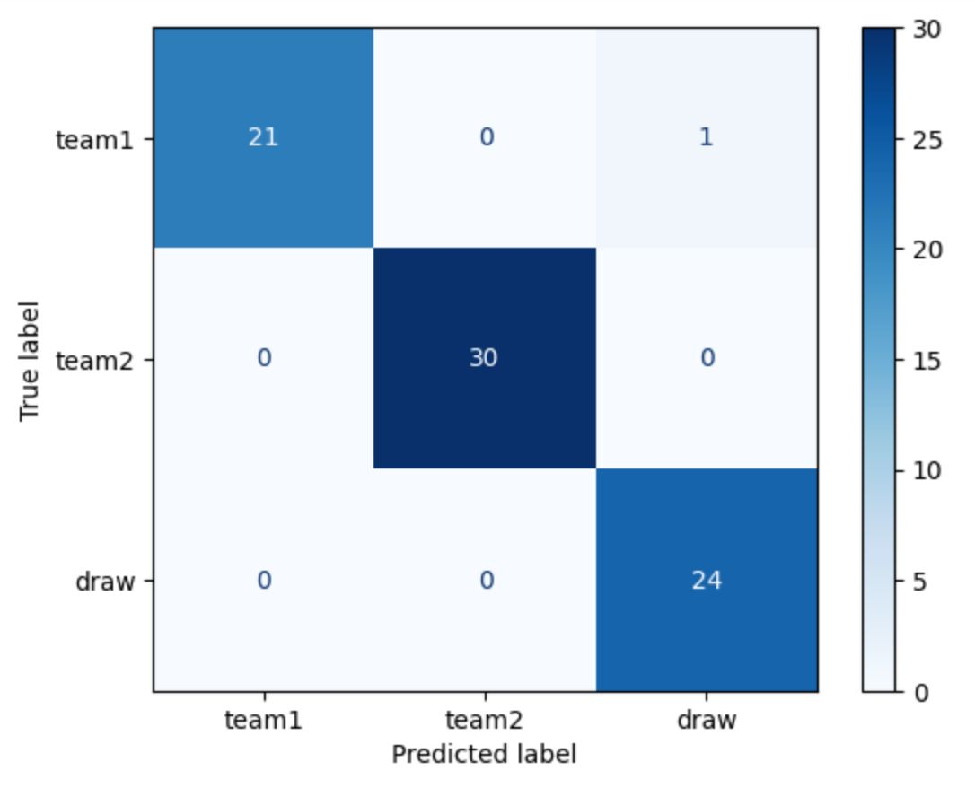
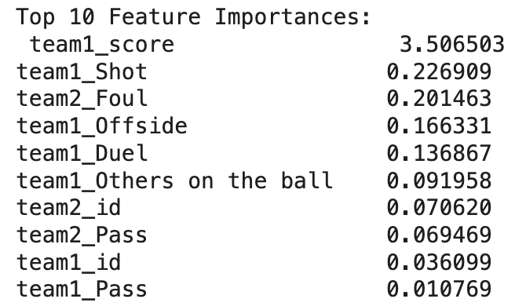
Model 1: Logistic Regression
This model found team1_score, team1_shot, and team2_foul to be the most significant factors for predicting the end-game results
Average Accuracy = 0.9776

Slide 7
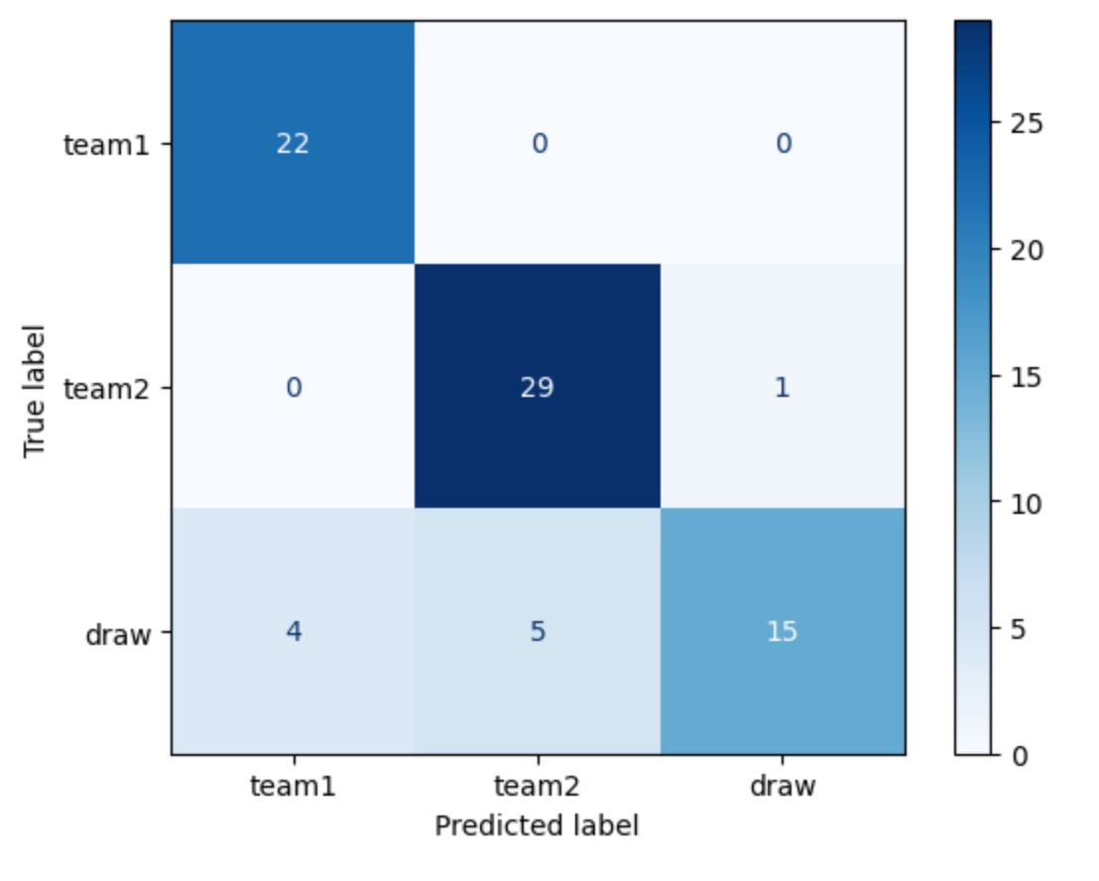
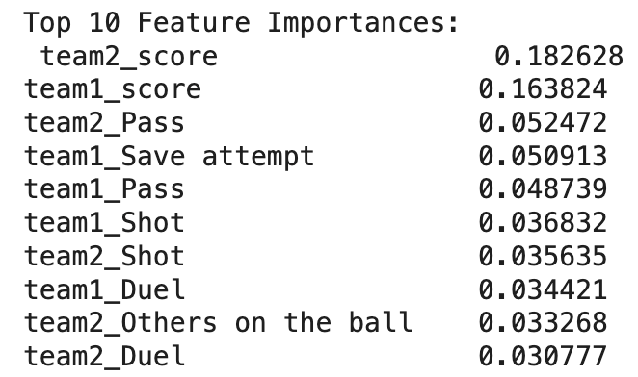
Model 2: Random Forest
This model found team2_score, team1_score, and team2_pass to be the most significant factors for predicting the end-game results
Average Accuracy = 0.8368

Slide 8
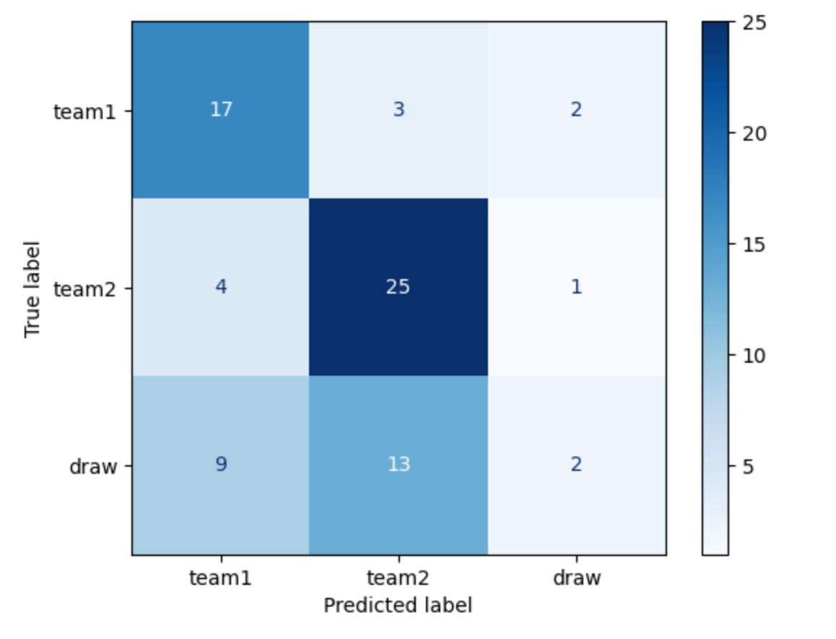
Model 3: K-Nearest Neighbors (KNN)
K = 5 to offer a sufficient balance between low variance and low bias
Not learning weights or building trees prevents the inclusion of a list of essential features
No inherent feature importance
Average Accuracy = 0.6211

Slide 9
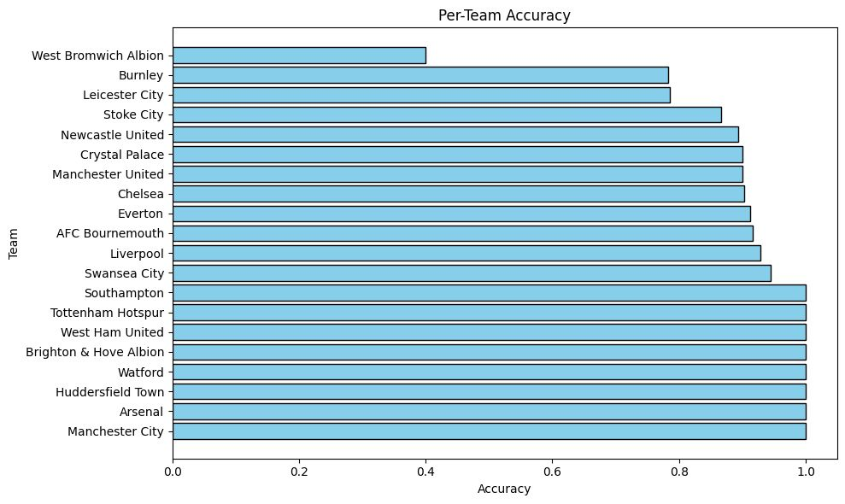
Per-Team Accuracy Plot

Slide 10
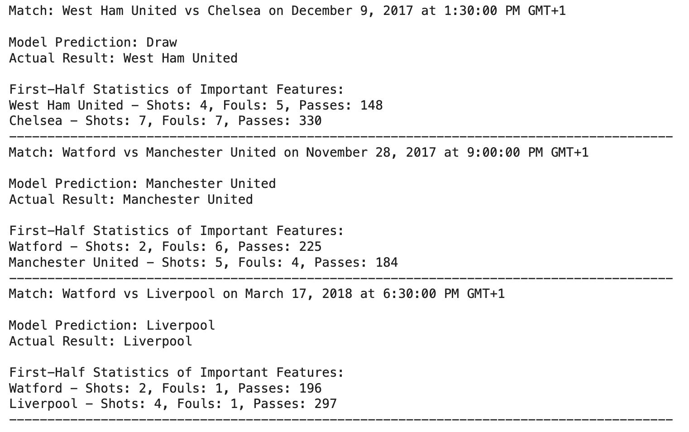
Our Predictions

Slide 11
Conclusion
Football game results can be reasonably predicted using first-half match statistics as early-game patterns carry strong indicators about final results, but the model choice is key
Random Forest consistently delivered the highest predictive performance, identifying key indicators such as early scores and passing activity
Logistic Regression highlighted shot counts and fouls as important, while KNN showed lower performance and does not provide feature importance
Teams with more consistent first-half performances, like Manchester City & Arsenal, are easier to predict, while others, like West Brom, are trickier to predict

Slide 12
Thank You ☺️

